Slide 1
Texture Mapping
Matt Evett
Eastern Michigan University

Slide 2
Objectives
Introduce Mapping Methods
  Texture Mapping
  Environmental Mapping
  Bump Mapping
Consider basic strategies
  Forward vs backward mapping
  Point sampling vs area averaging
Angel: Interactive Computer Graphics 3E © Addison-Wesley 2002

Slide 3
The Limits of Geometric Modeling
Although graphics cards can render over 10 million polygons per second, that number is insufficient for many phenomena
  Clouds
  Grass
  Terrain
  Skin
Angel: Interactive Computer Graphics 3E © Addison-Wesley 2002

Slide 4
Modeling an Orange
Consider the problem of modeling an orange (the fruit)
Start with an orange-colored sphere
  Too simple
Replace sphere with a more complex shape
  Does not capture surface characteristics (small dimples)
  Takes too many polygons to model all the dimples
Angel: Interactive Computer Graphics 3E © Addison-Wesley 2002

Slide 5
Modeling an Orange (2)
Take a picture of a real orange, scan it, and “paste” onto simple geometric model
  This process is texture mapping
Still might not be sufficient because resulting surface will be smooth
  Need to change local shape
  Bump mapping
Angel: Interactive Computer Graphics 3E © Addison-Wesley 2002

Slide 6
Three Types of Mapping
Texture Mapping
  Uses images to fill inside of polygons
Environmental (reflection mapping)
  Uses a picture of the environment for texture maps
  Allows simulation of highly specular surfaces
Bump mapping
  Emulates altering normal vectors during the rendering process
Angel: Interactive Computer Graphics 3E © Addison-Wesley 2002

Slide 7

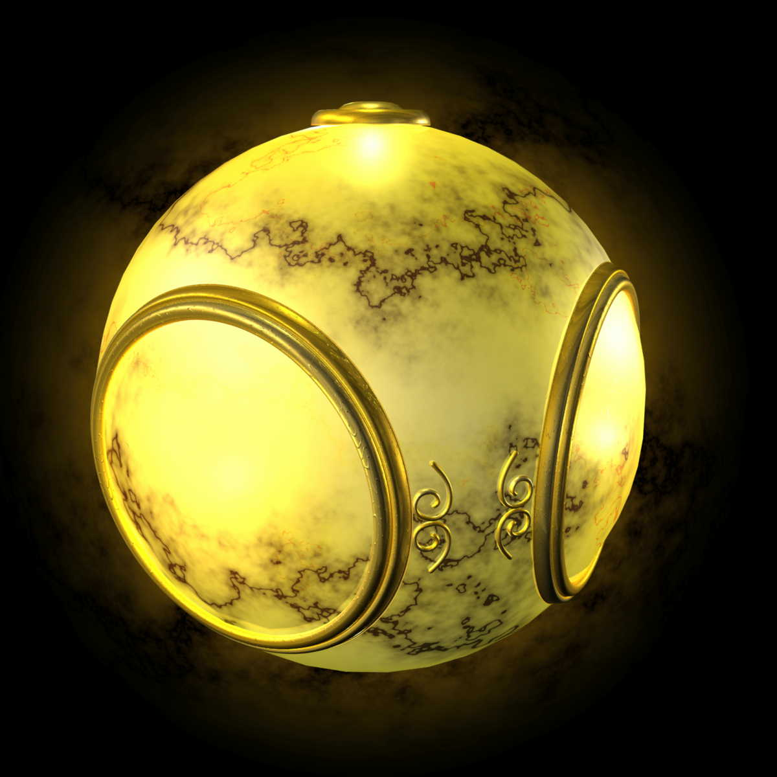
Texture Mapping
geometric model
texture mapped
Angel: Interactive Computer Graphics 3E © Addison-Wesley 2002

Slide 8

Environment Mapping
Angel: Interactive Computer Graphics 3E © Addison-Wesley 2002

Slide 9

Bump Mapping
Angel: Interactive Computer Graphics 3E © Addison-Wesley 2002

Slide 10
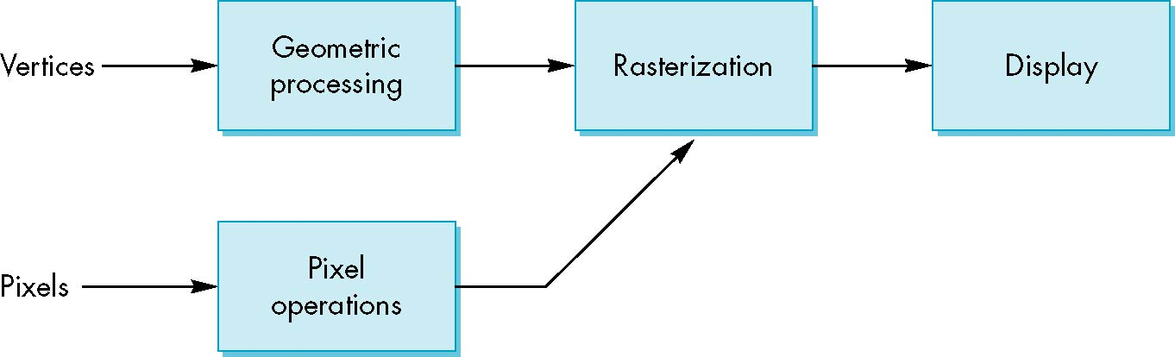
Where does mapping take place?
Mapping techniques are implemented at the end of the rendering pipeline
  Very efficient because few polygons pass down the geometric pipeline (due to hidden surface removal)
Angel: Interactive Computer Graphics 3E © Addison-Wesley 2002

Slide 11
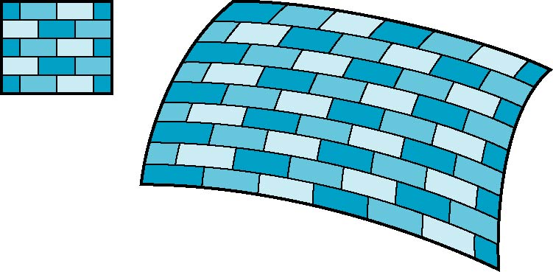
Is it simple?
Although the idea is simple---map an image to a surface---there are 3 or 4 coordinate systems involved
2D image
3D surface
Angel: Interactive Computer Graphics 3E © Addison-Wesley 2002

Slide 12
Coordinate Systems
Parametric coordinates
  May be used to model curved surfaces
Texture coordinates
  Used to identify points in the image to be mapped
World Coordinates
  Conceptually, where the mapping takes place
Screen Coordinates
  Where the final image is really produced
Angel: Interactive Computer Graphics 3E © Addison-Wesley 2002

Slide 13
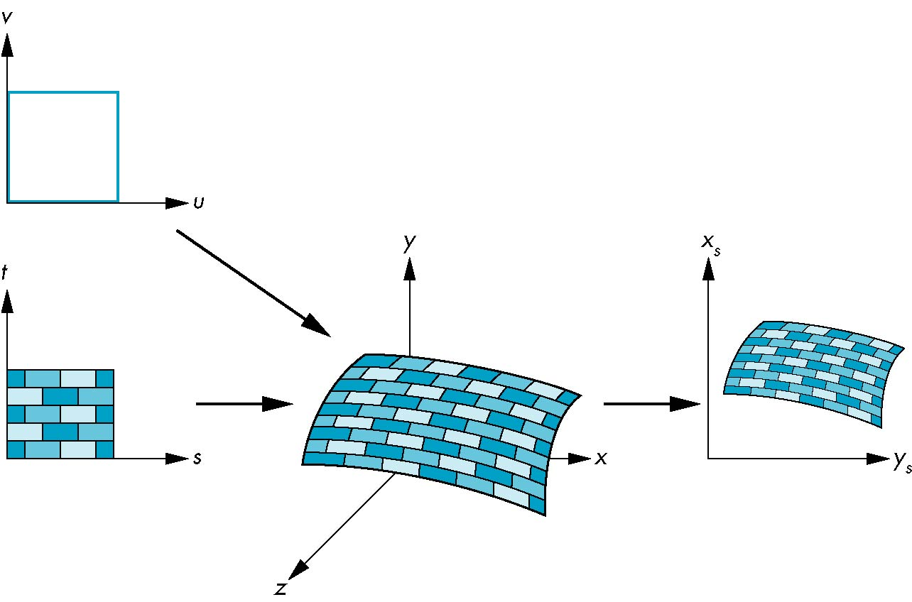
Texture Mapping
parametric coordinates
texture coordinates
screen coordinates
world coordinates
Angel: Interactive Computer Graphics 3E © Addison-Wesley 2002

Slide 14
Mapping Functions
Basic problem is how to find the maps
Consider mapping from texture coordinates to a point on a surface
Appear to need three functions
  x = x(s,t)
  y = y(s,t)
  z = z(s,t)
But we really want
to go the other way
(x,y,z)
t
s
Angel: Interactive Computer Graphics 3E © Addison-Wesley 2002

Slide 15
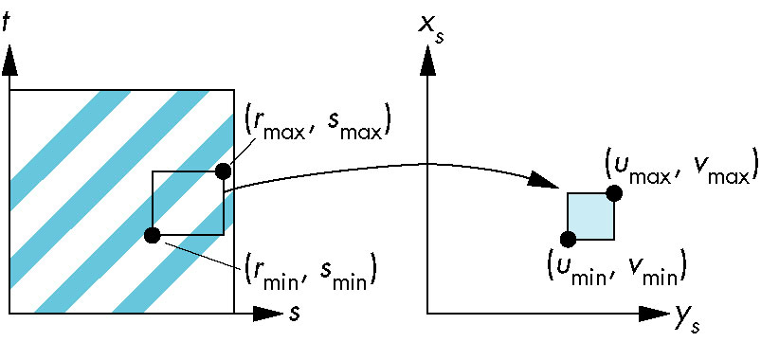
Curved Surfaces
Usually defined parametrically (in u,v)
Angel: Interactive Computer Graphics 3E © Addison-Wesley 2002
Notes:
Invertible so long as ac != bd. See notes (top of 123 and 123b) for calculation of inverses.

Slide 16
Backward Mapping
We really want to go backwards
  Given a pixel, we want to know to which point on an object it corresponds
  Given a point on an object, we want to know to which point in the texture it corresponds
    Need mapping functions of the form
    s = s(x,y,z), or s=s(u,v)
    t = t(x,y,z), or t=t(u,v)
Such functions are difficult to find in general
Angel: Interactive Computer Graphics 3E © Addison-Wesley 2002

Slide 17
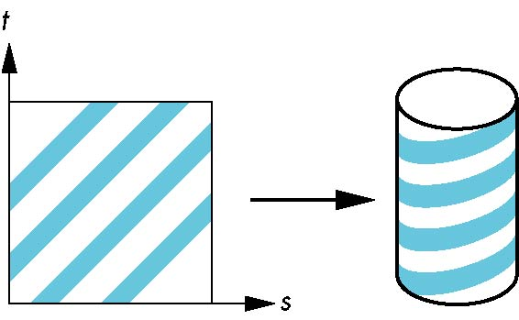
Two-part mapping
One solution to the mapping problem is to first map the texture to a simple intermediate surface, then to actual surface
Example: map to cylinder
Angel: Interactive Computer Graphics 3E © Addison-Wesley 2002

Slide 18
Cylindrical Mapping
parametric cylinder
x = r cos 2π u
y = r sin 2πu
z = v/h
maps rectangle in u,v space (0,1) to cylinder
of radius r and height h in world coordinates
s = u
t = v
maps from texture space
Angel: Interactive Computer Graphics 3E © Addison-Wesley 2002

Slide 19
Spherical Map
We can use a parametric sphere
x = r cos 2πu
y = r sin 2πu cos 2πv
z = r sin 2πu sin 2πv
in a similar manner to the cylinder
but have to decide where to put
the distortion
Spheres are used in environmental maps
Angel: Interactive Computer Graphics 3E © Addison-Wesley 2002

Slide 20
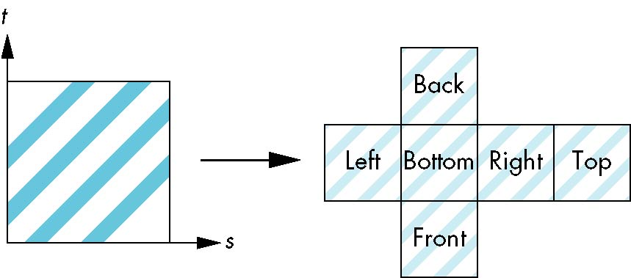
Box Mapping
Easy to use with simple orthographic projection
Also used in environmental maps
Angel: Interactive Computer Graphics 3E © Addison-Wesley 2002

Slide 21
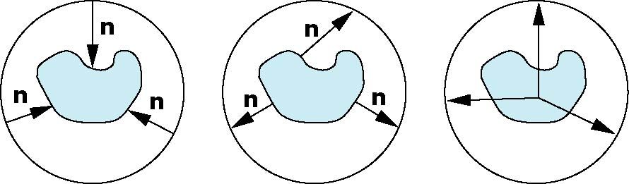
Second Mapping
Map from intermediate object to actual object
  Normals from intermediate to actual
  Normals from actual to intermediate
  Vectors from center of intermediate
actual
intermediate
Angel: Interactive Computer Graphics 3E © Addison-Wesley 2002

Slide 22
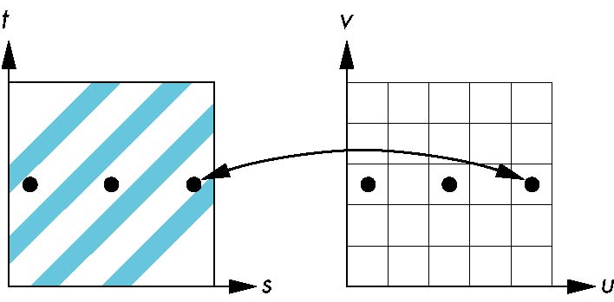
Aliasing
Point sampling of the texture can lead to aliasing errors
miss blue stripes
point samples in u,v
(or x,y,z) space
point samples in texture space
Angel: Interactive Computer Graphics 3E © Addison-Wesley 2002
Notes:
Setting a pixel to be the color of the texture where the projector pierces center of the pixel.

Slide 23
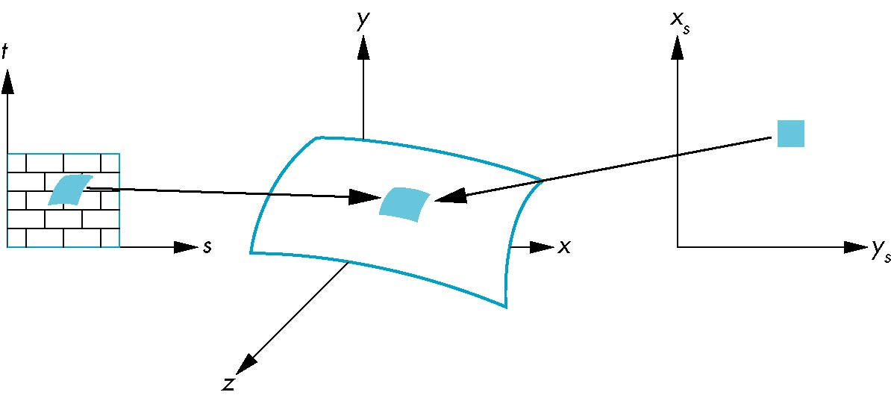
Area Averaging
A better but slower option is to use area averaging
pixel
preimage
Note that preimage of pixel is curved
Angel: Interactive Computer Graphics 3E © Addison-Wesley 2002
Notes:
Aliasing is still possible, and is especially pronounced when textures have regularly repeating patterns (e.g. stripes, polka dots), as the averaging can blur the texture so much that the texture’s pattern is lost.

